Slide 1
Retrieval practice

Slide 2
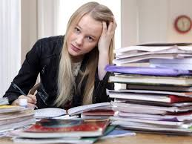
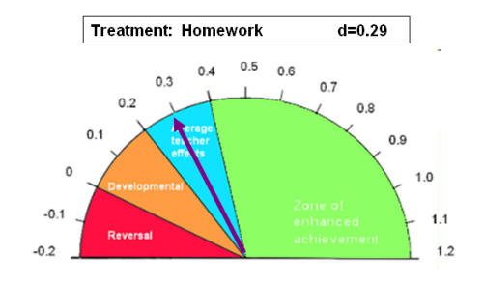
HOMEWORK ☹

Slide 3
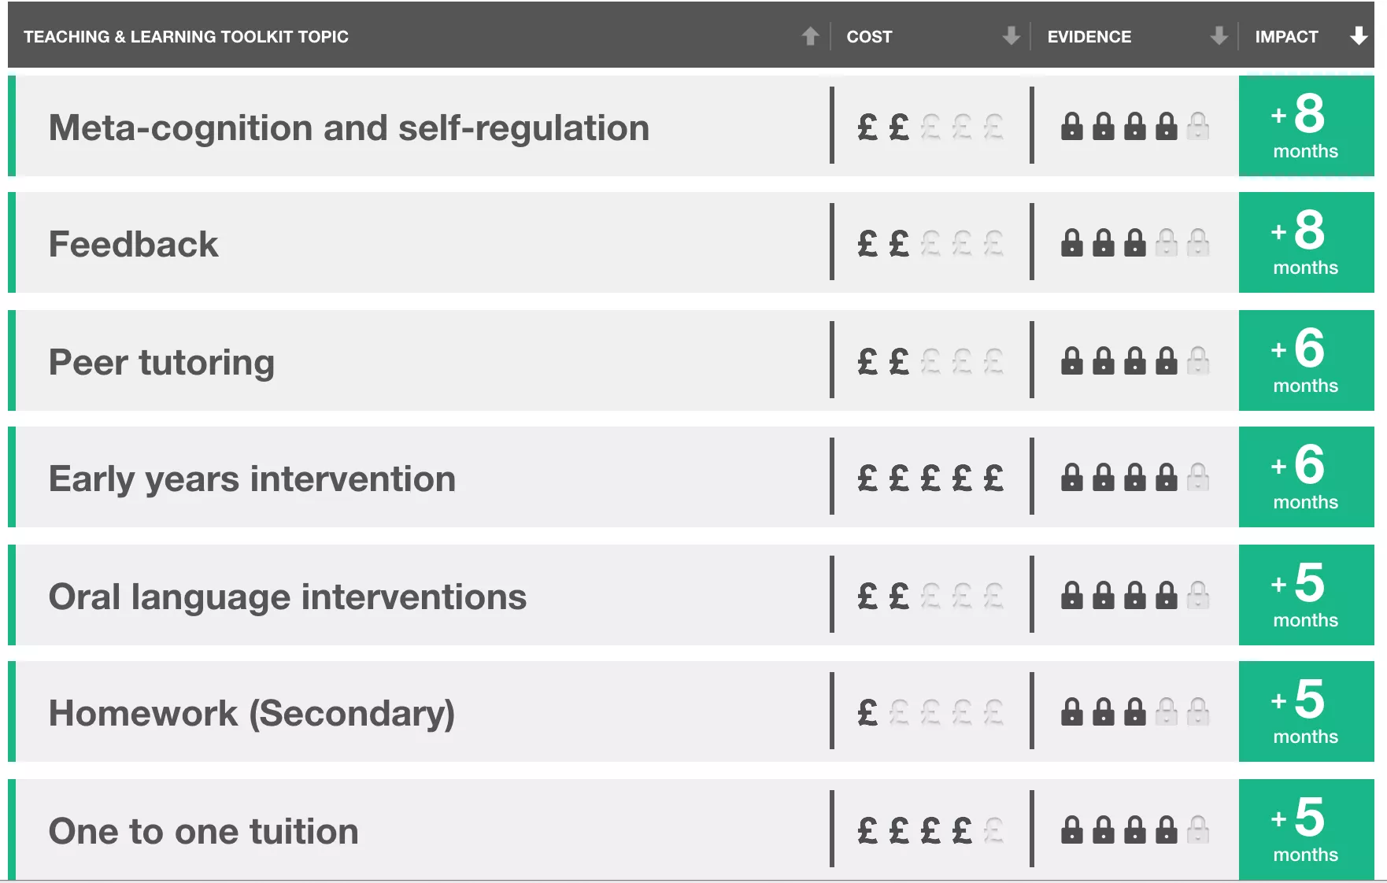
HOMEWORK ☹
Professor Dylan Wiliam, deputy director of the Institute of Education, says: "Getting pupils to do homework is an incredibly expensive and generally unproductive public relations exercise. Schools push homework because they think parents like it, but most schools don't plan homework well enough for it to be worth doing. This is not to say that homework cannot be good, just that most of it currently isn't."

Slide 4
We don’t want children wasting their time doing tasks that don’t impact on learning
We don’t want parents having to constantly nag their children to complete things they don’t understand
We don’t want to stress out parents if they don’t know how to help their child (or with the nagging!)
We don’t want parents doing the homework for their children!

Slide 5
We want homework to perfectly match the work they are doing in school so that it supports and reinforces each other
We want homework to support children becoming independent learners, using cognitive strategies that suit them as individuals
We want homework to support our work on metacognition
We want homework to be consistent in application so that anxieties about what to do and doing it right are reduced
We want homework to be flexible so that pupils can actively pursue other interests without homework getting in the way or being a burden. If you have scouts one night, or gymnastics practice – we want you to concentrate on this as it’s important. Homework can be fitted in around your schedules

Slide 6
Metacognition
Meta =
beyond
Learning to Learn

Slide 7
Retrieval time!

Slide 9
Memory not memories – teaching for long term learning
Retrieval process
Unfortunately this effect is also known as the ‘testing effect’ which puts some teachers off and confuses others – myself included until recently – so that we see this as an assessment tool. It is not an assessment tool, it is a learning tool. I fear my previous blogs on knowledge organisers might have reinforced that misunderstanding. You might get some assessment data as a by product from some retrieval practice but that is not its prime purpose. Its prime purpose is to make memories stronger.
Claire Sealy

Slide 12
Retrieval time!

Slide 14
The retrieval effect is stronger if we allow a bit of forgetting to happen before getting children to retrieve. Using our hide and seek analogy, if you only count to 5 before you go and ‘seek’, your friends will be pretty easy to find but your ‘seeking skills’ won’t have had much of a work out. Count to 50 and your friends will be well hidden and you will have to work hard to find them. It’s the same with memory. Our memories get stronger once retrieved if we have had time to forget them – bizarre as that sounds.

Slide 16
Knowledge Organisers
- the information you need to get INTO the long term memory
Each child will get a knowledge organiser for every subject. The knowledge organiser contains in the region of 30 key pieces of information that are the basic building blocks of knowledge.
Pupils learn this information for homework using whatever cognitive strategy they want to

Slide 17
Retrieval means…
Retrieval Practice - checking how much information you can get OUT OF the long term memory
Testing
Direct verbal questions
Self questioning
Writing notes from memory
Using flash cards
Writing essays
Writing mind maps from memory
All information is retrieved rather than passively heard or re-read

Slide 18
Home learning will be a combination of both
INTO the memory bank
OUT OF the memory bank
REFLECT on strategy

Slide 19
Retrieval time!

Slide 21
Metacognition =
Learning to Learn

Slide 22
Cognitive Challenge

Slide 23
10 x 1 =
9 | 1
11 | 10

Slide 24
9 x 7=
63 | 70
56 | 36

Slide 25
12 x 7=
91 | 84
77 | 48

Slide 26
2 x 3=
6 | 5
8 | 1

Slide 27
9 x 12=
120 | 108
96 | 801

Slide 28
7 x 5=
40 | 30
53 | 35

Slide 29
7 x 7=

Slide 30
6 x 8=

Slide 31
6 x 7=

Slide 32
11 x 4=

Slide 33
8 x 8=

Slide 34
8 x 12=

Slide 35
7 x 8=

Slide 36
10x1 | 6x8
9x7 | 6x7
12x7 | 11x4
2x3 | 8x8
9x12 | 8x12
7x5 | 7x8

Slide 37
10x1 = repetition | 6x8
9x7 | 6x7
12x7 | 11x4
2x3 = repetition | 8x8
9x12 | 8x12
7x5 | 7x8

Slide 38
10x1 = repetition | 6x8
9x7 | 6x7
12x7 | 11x4 = easy to remember visually ( until 11x11 & 12x11)
2x3 = repetition | 8x8
9x12 | 8x12
7x5 | 7x8

Slide 39
10x1 = repetition | 6x8
9x7 | 6x7
12x7 | 11x4 = easy to remember visually ( until 11x11 & 12x11)
2x3 = repetition | 8x8 = Rhyme
9x12 | 8x12
7x5 | 7x8

Slide 40
10x1 = repetition | 6x8
9x7 | 6x7
12x7 | 11x4 = easy to remember visually ( until 11x11 & 12x11)
2x3 = repetition | 8x8 = Rhyme
9x12 | 8x12
7x5 | 7x8 = visual 5-6-7-8

Slide 41
10x1 = repetition | 6x8
9x7 = always 1 lower (until 10x9) | 6x7
12x7 | 11x4 = easy to remember visually ( until 11x11 & 12x11)
2x3 = repetition | 8x8 = Rhyme
9x12 | 8x12
7x5 | 7x8 = visual 5-6-7-8

Slide 42
10x1 = repetition | 6x8
9x7 = always 1 lower (until 10x9) | 6x7
12x7 | 11x4 = easy to remember visually ( until 11x11 & 12x11)
2x3 = repetition | 8x8 = Rhyme
9x12 | 8x12 = 8x10 +16
7x5 | 7x8 = visual 5-6-7-8

Slide 43
10x1 = repetition | 6x8 = grrrrr!!!
9x7 = always 1 lower (until 10x9) | 6x7
12x7 | 11x4 = easy to remember visually ( until 11x11 & 12x11)
2x3 = repetition | 8x8 = Rhyme
9x12 | 8x12 = 8x10 +16
7x5 | 7x8 = visual 5-6-7-8

Slide 44
10x1 = repetition | 6x8 = grrrrr!!!
9x7 = always 1 lower (until 10x9) | 6x7 = grrr x2= visual
12x7 | 11x4 = easy to remember visually ( until 11x11 & 12x11)
2x3 = repetition | 8x8 = Rhyme
9x12 | 8x12 = 8x10 +16
7x5 | 7x8 = visual 5-6-7-8

Slide 45
Retrieval time!

Slide 47
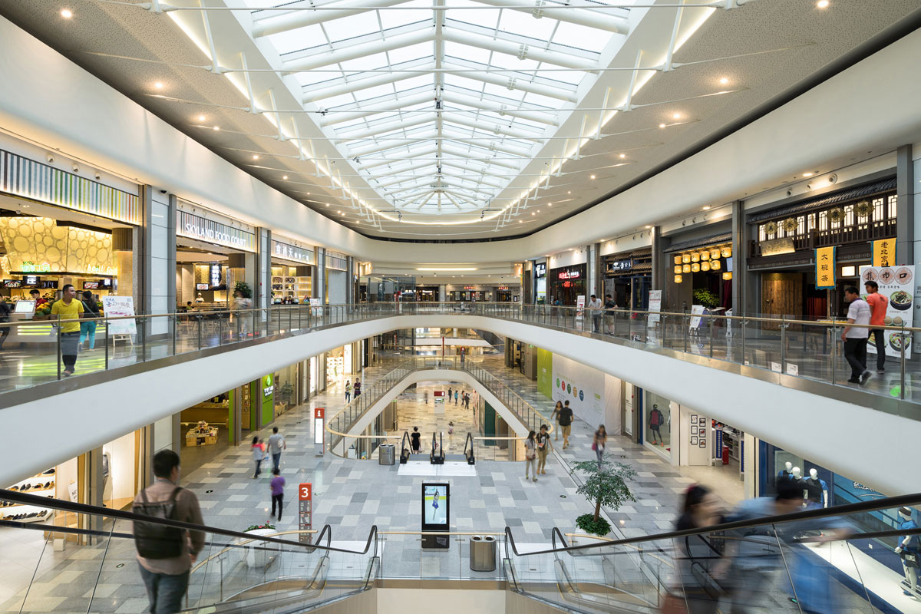
Let’s go shopping !

Slide 48
What shops?
Tesco
John Lewis
Salamander
Bertie’s Sweet Shop

Slide 49
something such as a very short poem or a special word used to help a person remember something:
The musical notes on the lines go EGBDF - use the mnemonic
"Every Good Boy Deserves Fun"
The colours of a rainbow—use the mnemonic “Richard Of York Gave Battle In Vain”
Points of a compass—use the mnemonic “Naughty Elephants Squirt Water”
Difficult spellings – I Sat On Swanage Cliffs Eating Lovely
Egg Sandwiches = isosceles
Mnemonics

Slide 50
Find a mnemonic for the shops you need to visit
Mnemonics

Slide 51
What shall we buy at TESCO?
Carrots
Honey
Porridge oats
Orange juice
Tea bags
crisps

Slide 52
Peg Words
a memory aid that involves linking
words with numbers
• one - gun
• two - shoe
• three - tree
• four - door
• five - hive
• six - sticks
If you have a list of things to memorize, like a shopping list, you can associate each item of the list with a number rhyme image. So if your shopping list is: carrots, milk, bread, eggs, rice, etc., make associations like this:
• One is "gun" -- imagine a gun shooting a pile of carrots, the first item on your shopping list.
• Two is "shoe" -- imagine cleaning your muddy shoe with a bottle of milk.
• Three is "tree" -- imagine bread growing on a tree.
• Four is "door" -- imagine throwing eggs at a door.
• Etc.
Once you've associated each item in your shopping list with a number peg, you'll be able to mentally walk through the numbers, recall the rhymes ("what was the gun shooting?"), and recall the item ("carrots")

Slide 53
Peg Words
Use peg words
to remember your shopping list

Slide 54
What shall we buy at John Lewis?
A television
Shoes
Duvet cover
Sonos Soundbar
New hat

Slide 55
LOCI
Linking visual items to a story.
Memory experts sometimes refer to the Method of Loci as the 'Memory Palace.'
Instead of taking a mental walk through a specific route, they visualize items to be memorized in different imaginary rooms in their palace
Let’s suppose that you want to memorize the following list:
o Monkey o Computer o Apples o Soccer o Bike o Steak o Mobile phone
You could use the method like this: I wake up in my bedroom and the first thing I see as I open my eyes is a monkey that stares at me. As I move to the bathroom I see a post-it paper on the mirror writing “Your computer is broken”. Damn this monkey broke it. I make my way to the second bedroom and on the desk I see a basket full of rotten apples and they smell terrible (sensual data increase memory capacity).
I throw them out of the balcony. As I move to the living room, the TV is on playing the Champions league soccer final and I watch for a while. As I move to the kitchen I take the small bike bag from the table and I move to the refrigerator to take the steak I cooked the previous day. I walk to the front door and as I close it behind me I hear the mobile phone ringing from the inside (creates an annoying feeling because I forgot to take the mobile phone with me – feelings also increase memory capacity).
This is a very simple example of the method of loci. As you can imagine, you can memorize a lot more things by creating more stop points. For instance, you can think every piece of furniture of the house as a new point. It is not necessary to change rooms to remember the next item. You can memorize multiple objects in the same room by simply associating them with different locations in the same room. In my example, I placed the bike bag and the steak in the same room but at different locations; the bag was on the table while the steak was in the fridge

Slide 56
LOCI
Use LOCI to remember your John Lewis list

Slide 57
What shall we buy at Salamander?
Frying pan
Fork
Apron
Spoon
Butter dish

Slide 58
chanting
Chanting is a type of repetition practice
Chant the words, preferably in a rhythmic manner and repeat

Slide 59
chanting
Use chanting to remember the salamander list

Slide 60
What shall we buy at Bertie’s sweet shop?
You can have all you can eat!!!!
I went to the shop and bought a lolly
I went to the shop and bought….

Slide 61
Association
Association is a technique whereby you link hard to remember information to relevant or logical things
If memory works by association, we actively work to create an association between two bits of information. For example, for the plane that we need to catch at 2 P.M., we can imagine the plane in our mind, and notice that it has 2 wings. Two wings, 2 P.M. There’s an association. We are now ten times more likely to remember the take-off time long after it has faded from our short-term memory.

Slide 62
Association
How many can you remember?

Slide 63
So …how good at shopping are you?

Slide 64
Retrieval time!

